Slide 1
Analyzing Agent Upgrade Logs using Anomaly Detection
April, 2021

Slide 2
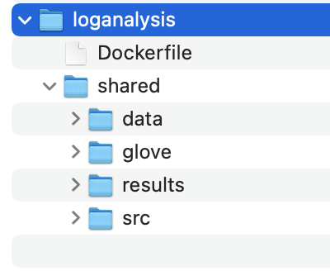
Environment
Docker image with libraries installed
Ubuntu base image
Python 3
Pyod (Python Outlier Detector)
Numpy
Tensorflow, keras
Source code, data and working directory on local filesystem
shared -> working directory mount point
data -> training data, test data, target data
glove -> pre-trained word2vec files
results -> output from application
src -> source code (python)

Slide 3
Design
Log Collection
Smartnode bundles
tenant.log files uncompressed and concatenated to a single file
Placed in a folder in the data directory
Log Parsing
Logs are narrowed down to those that have an ’ACTIVITY_ID’
Sanitized by removing variables
Each log line converted into json object with date, message and other fields.
The successful and failed AAU runs are separated out and stored in the results directory into individual files for each run.
Only the successful runs are used for unsupervised (unlabeled) training

Slide 4
Design (cont…)
Feature Extraction
Word Embeddings – feature vectors for words
Glove – pre-trained set of vectors for each word
Each word in the message is converted to a number by looking it up from glove dictionary index.
Sentences are restricted to a max length or padded with 0s
Training the model
data only from the successful AAU runs
Use PyOD with kNN and fit the training data to create model
Save the model
Anomaly Detection
Load the pre-trained model
Identify the outliers and trace it back to the original log details.

